Slide 1

START UP IDEAS AND TEAM FORMATION
Asad Yousuf

Slide 2



Agenda
Recap for meeting one
Alumni massage
Task
Startup ideas
Team build up
conclusion

Slide 3
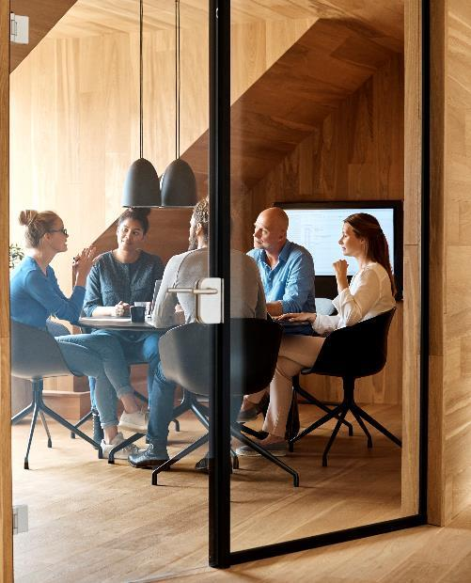



GOAL
LET'S US BUILT AI PRODUCT,SERVICE AND API

Slide 4

Recape
Brainstorming for AI project
Pros and cons of AI project
Strong Team cooperation
AI project proposal pitch

Slide 5
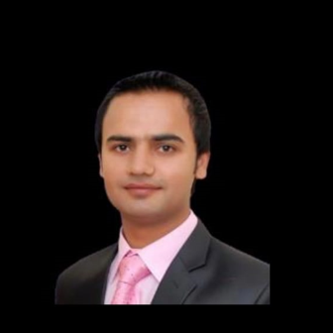
SENIOR OF AI PIAIC MASSAGE Nauman Shah

Slide 6
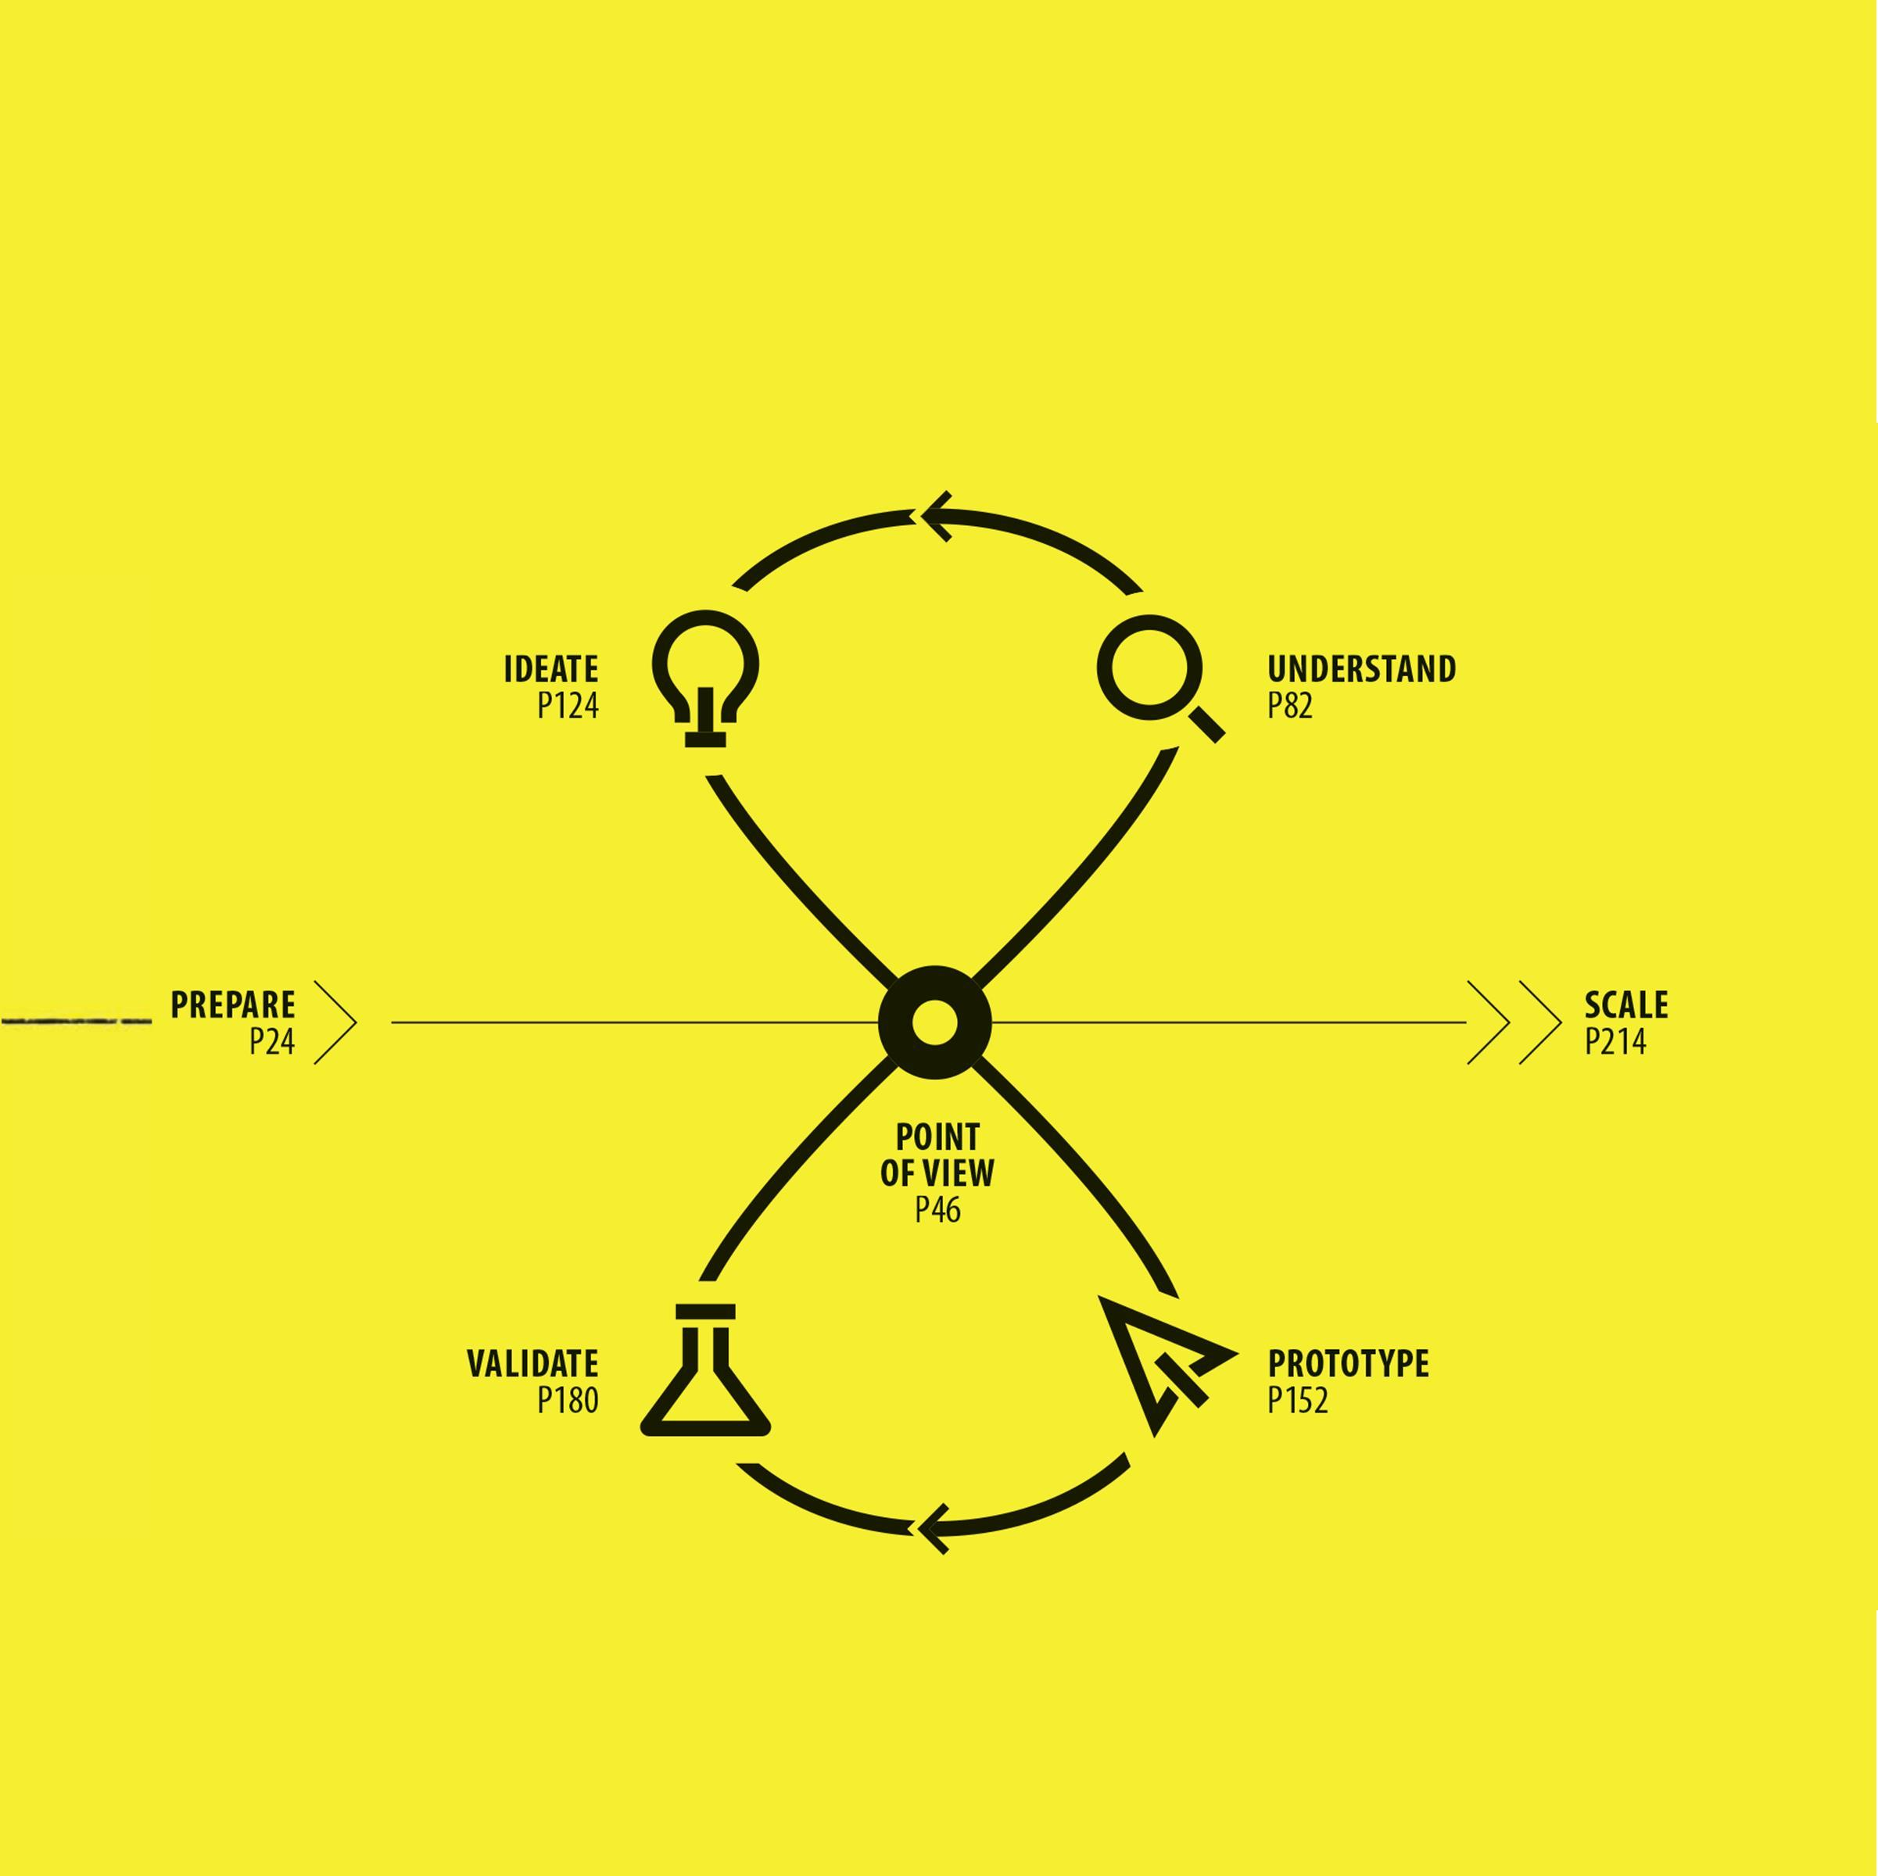
DARE TO START

Slide 7
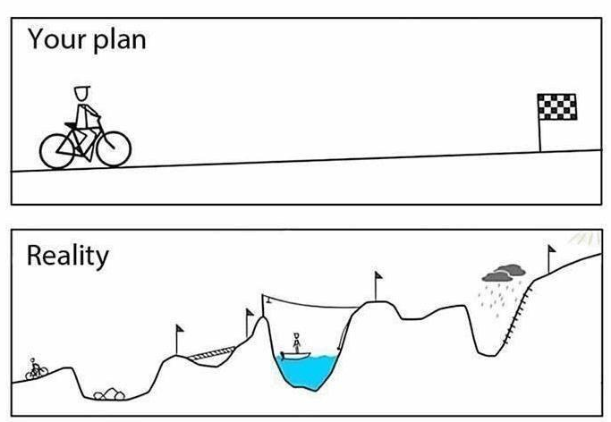

Slide 8
AI PROJECT
Smart spray for agriculture (Tariq jamiel)
Smoke and fire detection (ASAD YOUSUF)
Anomaly detection in video surveliance ( nouman)
Semantic word detection (mah jabien).
Quantification of fruit (Tariq).
Path mapping for drones (arughman)
Help to the new beginner for AI (abdulsamad)

Slide 9
AI PROJECT IDEAS
SMARTER RETAIL.
AUTOMATED CAR PARKING.
VIDEO TRANSLATION.
Analyzing Blood Cells in Seconds With Deep Learning
Object detection for blind person.

Slide 10
TEAM FORMATION
Teams should be 3 – 5 people (4 is ideal)
Teams should be formed before the next Meeting
Each team should have a business model canvas before next Meeting
Subscribe to your group / team.

Slide 11



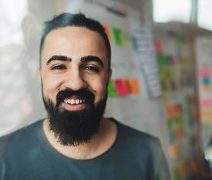
Team
Name
Name
Name
Name
Title
Title
Title
Title

Slide 12
TASK
Subtitle
AMAZON WEBSERVICE OFFER TO STARTUP PROJECT
MINUTE OF MEETING
INVITE ALMUNI OR INDUSTRY EXPERT
TIMETABLE FOR WEEK
Recording options

Slide 13


Thank You

